Slide 1
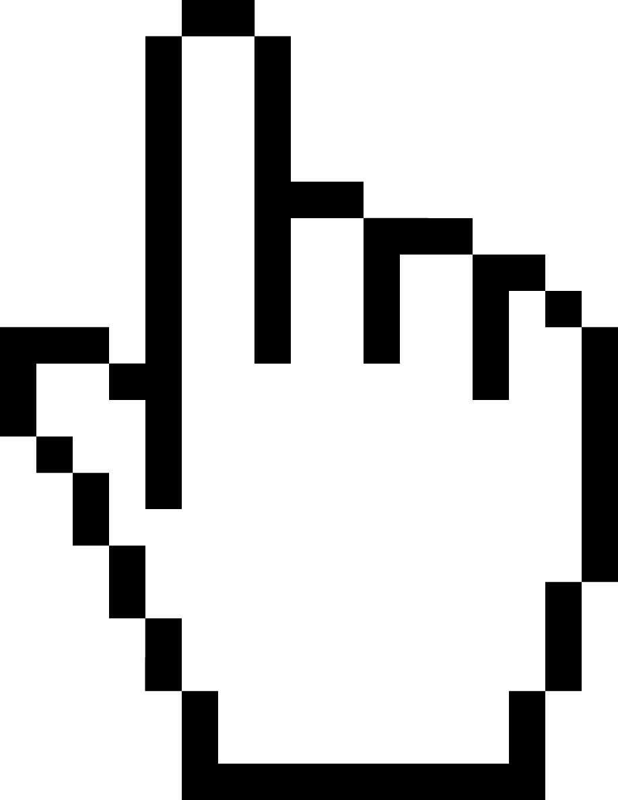
What is Know About the Click?
Click Through Actions are a strong indicator of a user’s engagement and of high value
CTA is difficult to scale…
In 2009 8% of users accounted for 85% of clicks. Now it’s 2%.
How can you scale into 2% of the online audience?

Slide 2
Problems with Click Through Actions: Audience
Significant data shows that the audience that clicks is not the same audience that converts
Clickers are more likely to be in a lower income range and less likely to commit to a purchase…whereas converters are more likely to be in a higher income range and less likely to click!
Targeting clickers may result in missing the desired audience.
Targeting clickers will ultimately ignore the audience who was served an ad and then navigates to your site and converts without ever having clicked.
The sparseness of click data impedes on any learning that our algorithm is capable of doing (due to few data points to learn from when only valuing CTA’s).
Notes:
If you’re optimizing to only those who have clicked and converted, the algorithm only has limited number of users to learn from. If view through actions are considered, the algorithm has much more users to optimize to- both users who were exposed to ads and eventually returned to the website and made a purchase

Slide 3
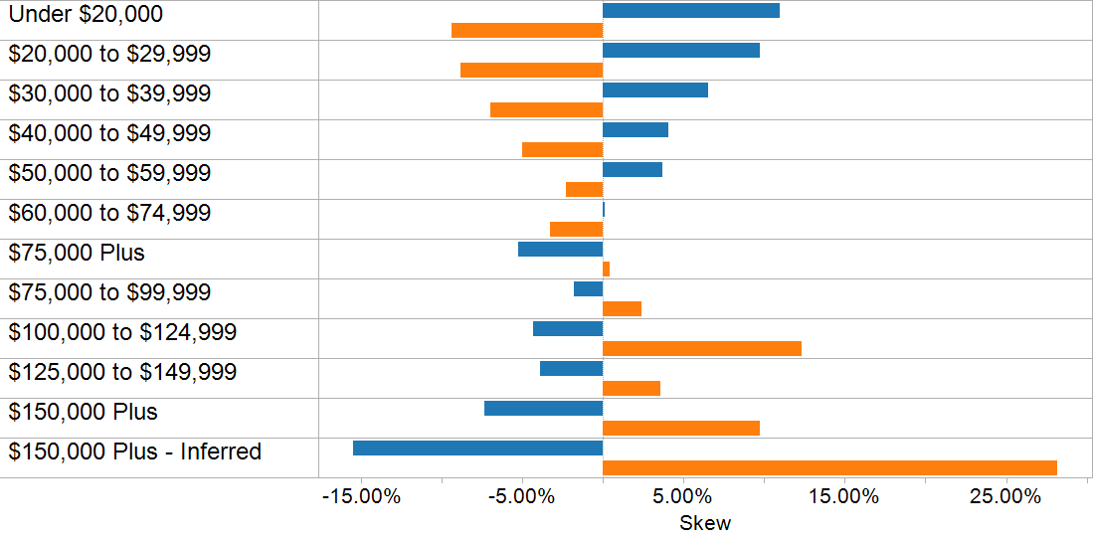
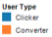
Problems with Click Through Actions: Audience

Slide 4
Problems with Click Through Actions: Converter Habits
Depending on the nature of conversion, it’s important to think about the converters purchasing habits and path to purchase
Are they going to click and immediately convert?
Or is the nature of the conversion one where they need to wait, think about it, and go to the website later to make the conversion?
This is especially true for Travel

Slide 5
Problems with Click Through Actions: Search vs Display
A search ad relates to an intent expressed by the user doing the search, so optimizing for clicks is essentially optimizing for conversions because they’re so closely aligned.
With display, if you optimize for clicks, you get more clicks. But as seen, display ad clickers are not often your converters. Users are browsing websites for information, entertainment and engagement with others- not to click on display ads that send them to your website at that moment.

Slide 6
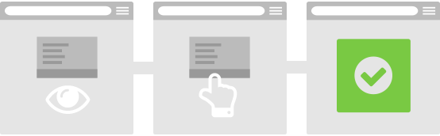
Value the View Through Action
The exclusion of View Through Actions as a KPI basically instructs our algorithm to incorporate behavior of a 2% population while omitting the remaining 98% of the population
Results in lost reach and missed opportunity to influence users who have not clicked to convert
Solution: Give value to view based conversions. The statistics are clear in that not many people click on ads, so value your campaigns correctly giving credit to view based conversions.

